Slide 1

Promoting a Healthier Lifestyle Behavior
Smoking Prediction Analysis
Team B06
Chen He
Khushi
Sricharan Mahavadi
Varun Kaza
12/6/2023

Slide 2
Problem Statement
Objective
Predicting Smoking
Habits based on physiological data
Why Important?
Providing a smarter, up-to-date smoking predictors with early warning features

Slide 3


Our Stakeholders
Individuals
Personal Health
Healthcare Providers
Enable Early Intervention
Tailored Health Advice
Public Health Organizations
Population-Level Impact
Evidence-Based Decision-Making
Risk Management
Premium Adjustment
Insurance Providers
1 in 14 Americans will be diagnosed with Lung cancer

Slide 4

About Dataset
Source: Korea National Health Insurance Service, containing 910,306 rows and 24 columns
0 sex
1 age
2 height
3 weight
4 waistline
5 sight_left
6 sight_right
7 hear_left
8 hear_right
9 SBP
10 DBP
11 BLDS
12 tot_chole
13 HDL_chole
14 LDL_chole
15 triglyceride
16 hemoglobin
17 urine_protein
18 serum_creatinine
19 SGOT_AST
20 SGOT_ALT
21 gamma_GTP
22 SMK_stat_type_cd
23 DRK_YN

Slide 5
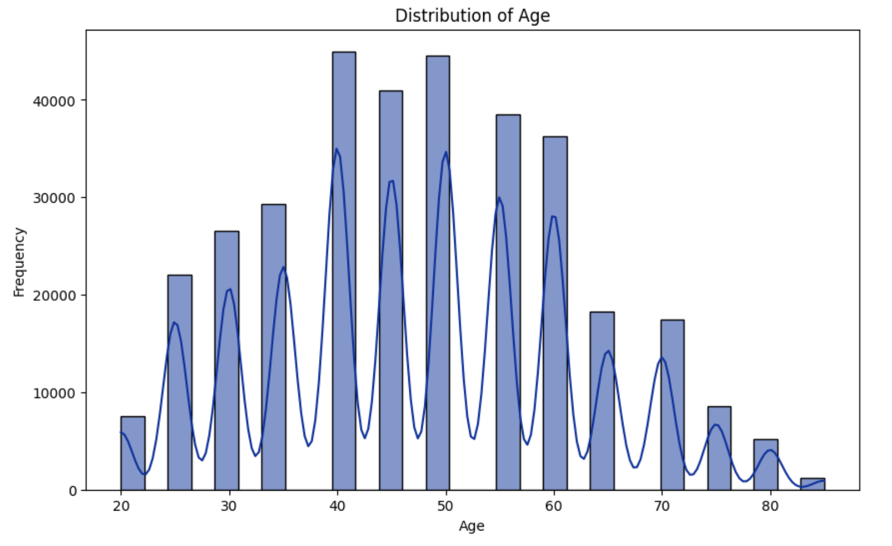
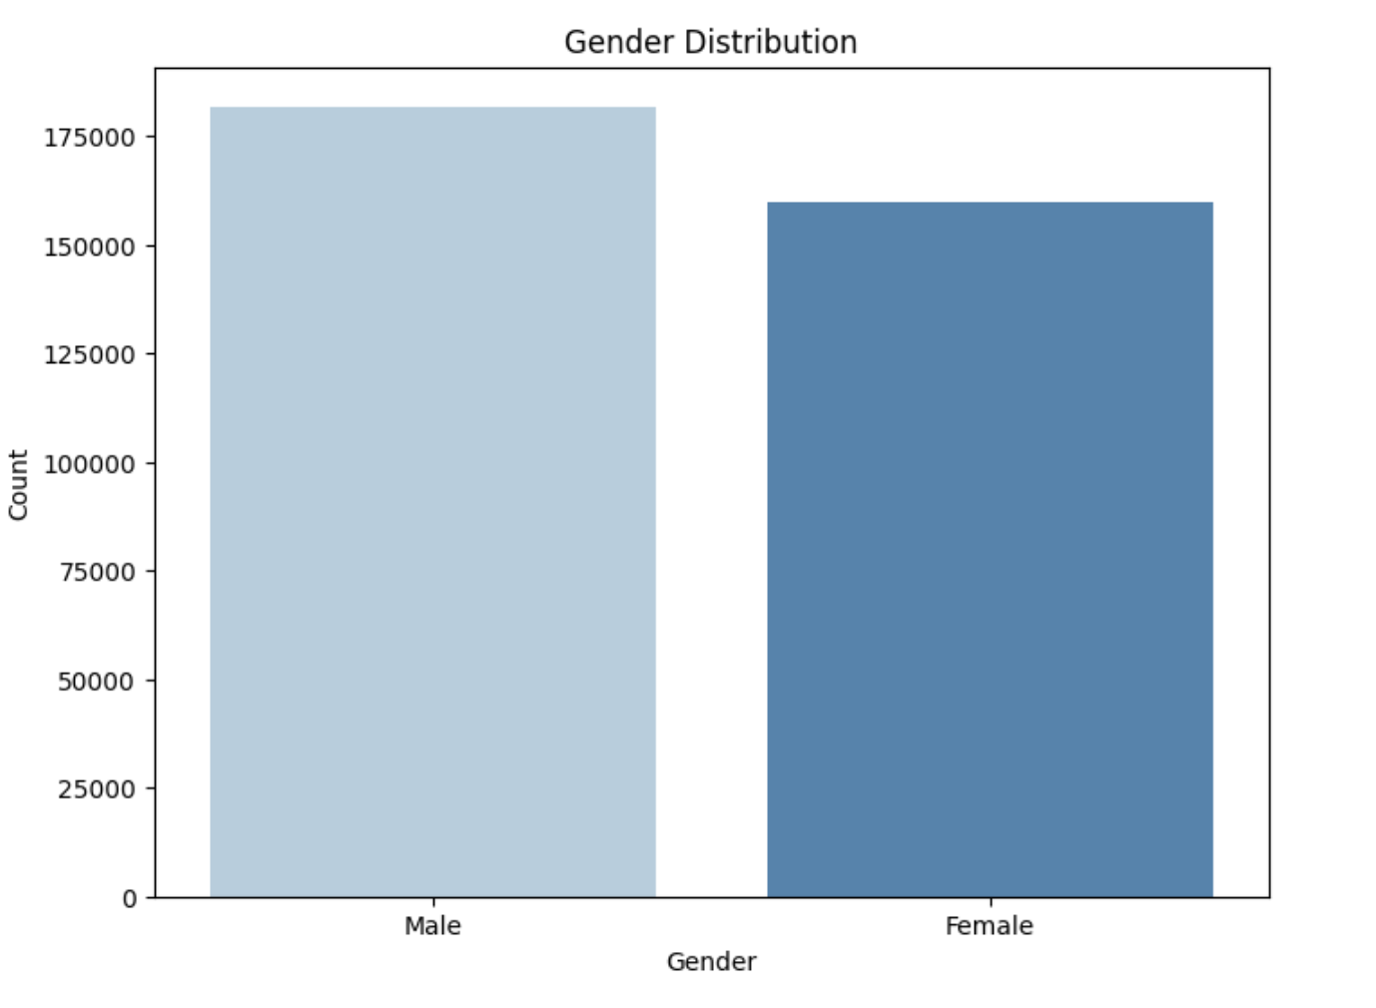
EDA - Distribution of Gender & Age

Slide 6
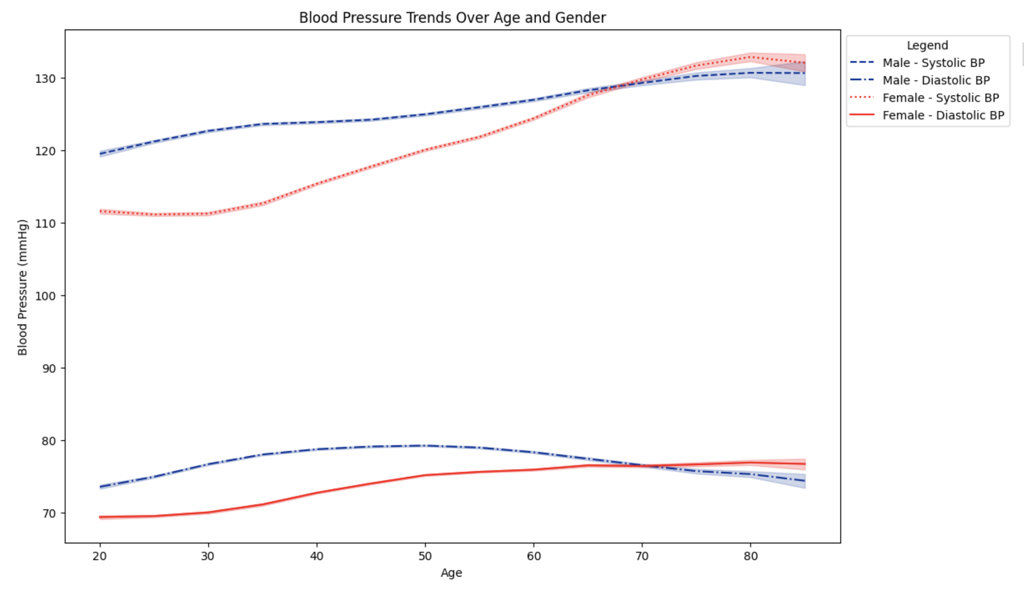
EDA - Blood Pressure Trends

Slide 7
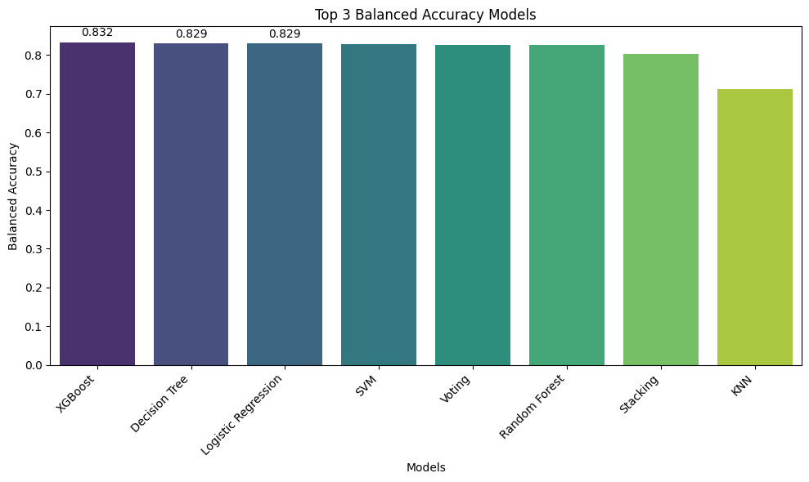
Main Results

Slide 8
Best Methods
XGBoost
Accuracy-0.832
Misclassification Cost – $1,682$
Decision Trees
Accuracy-0.829
Misclassification Cost – $1,272.4

Slide 9

Challenges
1. Dataset Size
100,000 entries - Huge dataset
2. Feature Engineering Complexity
Identifying meaningful features from raw data can be complex, especially when dealing with diverse dataset
3. Model Interpretability
Models may lack interpretability without having concrete evidence as to its performance
4. Data Quality and Cleaning
Real-world data is often noisy, incomplete, or contains errors that can affect model performance.
5. Scalability Issues
As the project scales, issues related to scalability started, affecting both model training and deployment

Slide 10
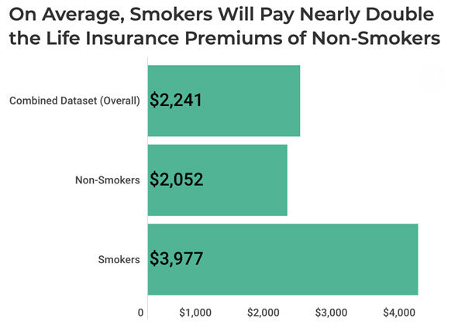
Conclusions
Best Model
Best Model: XGBoost with 83.2% balanced accuracy
Cost of Model
Decision Tree model had an average cost of $1272.4
Random Forest model had a slightly higher average cost of $1575.6
Best model XGBoost had a cost of $1680
Business Impact
Cost Implications: Annual Savings due to lower payouts
Fairness: Accurately charging patients for services provided
Prescriptive Intervention: Earlier interventions are possible

Slide 11
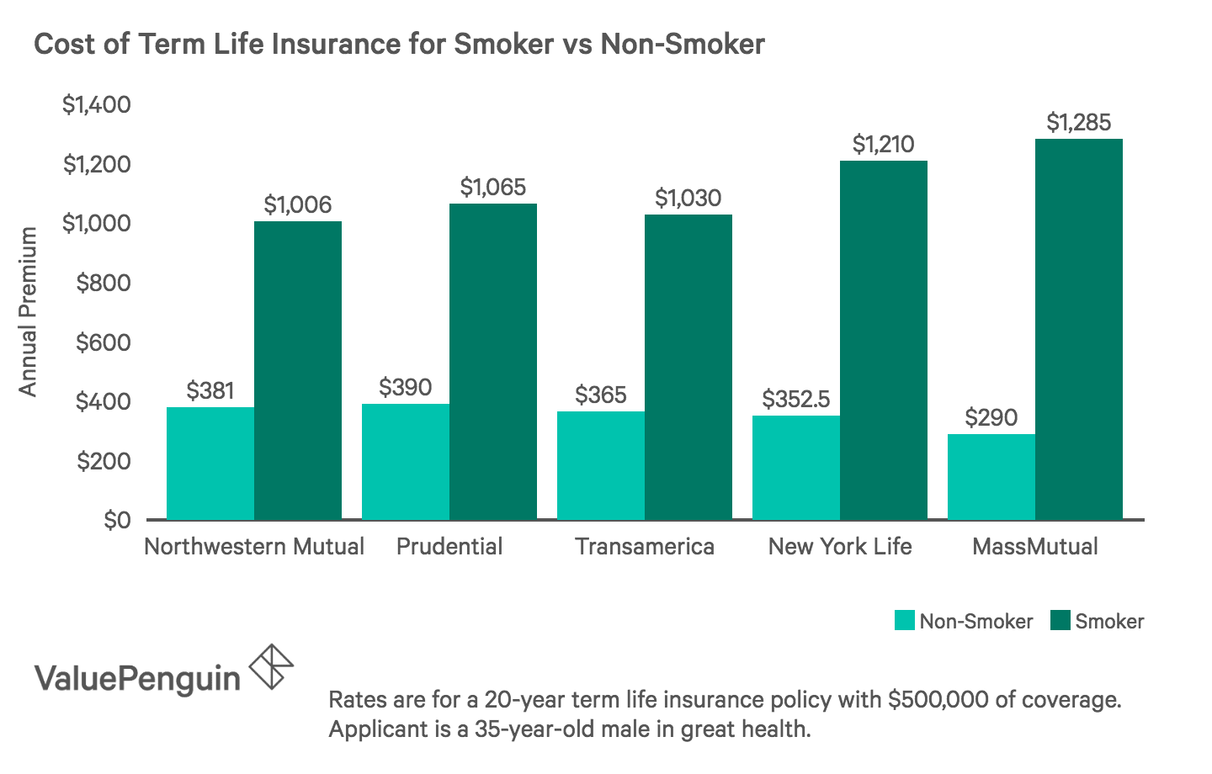
Insurance Rates Across Providers
Incentive to omit vital information:
The high cost of insurance is an incentive for the customer to withhold information
How Do Life Insurance Companies Find Out That You’re a Smoker?
Life Insurance Medical Exam
Pharmaceutical databases
Social Media
OUR MODEL

Slide 12
Real World Analysis
Sample Size = 100,000
Smokers=20,000
Non-Smokers=80,000
Sample Size = 100,000
Smoker Premium = 3450$
Non-Smoker Premium = 2000$
The Current System
$$\left(Smokers∗Premium\right)+(Non−Smokers ∗Premium)$$
Total Payout: 293,000,000$
Our Model – 83.32% Accuracy
$$\left(Missed Smokers∗Premium\right)+\left(Identified Non−Smokers∗Premium\right)$$
+ $\left(Missed Non−Smokers∗Premium\right)+(Identified Smokers∗Premium)$
Total Payout: 281,100,000$
Savings of $11,890,000

Slide 13

Thank You
Colab Link: https://colab.research.google.com/drive/1FyA-S01jiYnfqv0M_TW1iU7t-yWBPfsh?authuser=1#scrollTo=QogeawzOwO1M&uniqifier=9

